Slide 1

Orientation to Computing-I
L T P :2 0 0
www.lpu.in Lovely Professional University
1

Slide 2

Delivery method
Lectures- 2
Tutorial- 0
Practical- 0
Credits- 2
www.lpu.in Lovely Professional University
2

Slide 3
Course Outcomes
CO1 :: enumerate about the various functional components of a computer system
CO2 :: discuss the various components of operating system to get more insights about the functionalities of a digital computer
CO3 :: describe the different types of file systems and their applications to store and manage data
CO4 :: predict cohorts based upon their capability and accordingly gain the technical skills
CO5 :: understand the importance of various available pathways and getting insights to streamline their career
CO6 :: practice technical concepts using various tools and create technical profiles on different computing platforms
www.lpu.in Lovely Professional University
3

Slide 4
Program Outcomes
PO-1 Engineering knowledge::Apply the knowledge of mathematics, science, engineering fundamentals, and an engineering specialization to the solution of complex engineering problems.
PO-2 Problem analysis::Identify, formulate, research literature, and analyze complex engineering problems reaching substantiated conclusions using first principles of mathematics, natural sciences, and engineering sciences.
PO-3 Design/development of solutions::Design solutions for complex engineering problems and design system components or processes that meet the specified needs with appropriate consideration for the public health and safety, and the cultural, societal, and environmental considerations.
www.lpu.in Lovely Professional University
4

Slide 5
Program outcomes
PO-6 The engineer and society::Apply reasoning informed by the contextual knowledge to assess societal, health, safety, legal and cultural issues and the consequent responsibilities relevant to the professional engineering practice.
PO-12 Life-long learning::Recognize the need for, and have the preparation and ability to engage in independent and life-long learning in the broadest context of technological change.
PO-13 Competitive Skills::Ability to compete in national and international technical events and building the competitive spirit
www.lpu.in Lovely Professional University
5

Slide 6
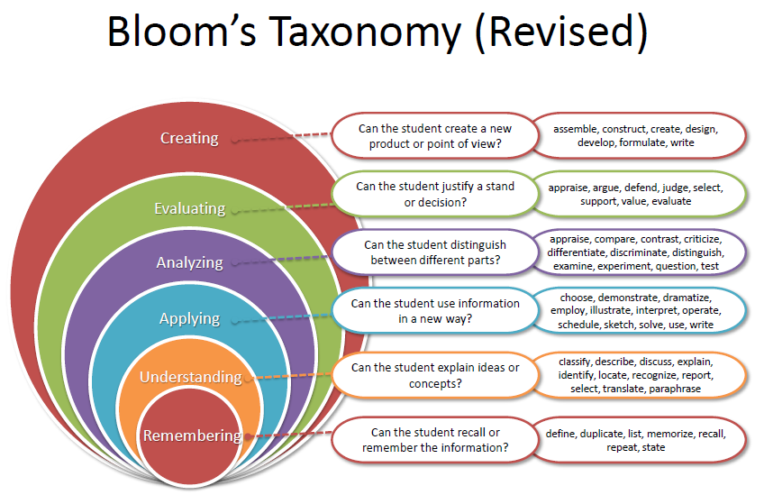
Bloom’s taxonomy
www.lpu.in Lovely Professional University
6

Slide 7
What are Cohorts
A group of students of a common programme who intend to attain similar characteristics by means of learning similar skills in order to target a particular career opportunity.

Slide 8
Purpose of Cohorts
Student shall be able to have a goal oriented approach for his/her career
Student identifies the goal in the very first year
Student shall be able to follow the stage wise career progression.
Early identification of skill set required for selected goal.

Slide 9
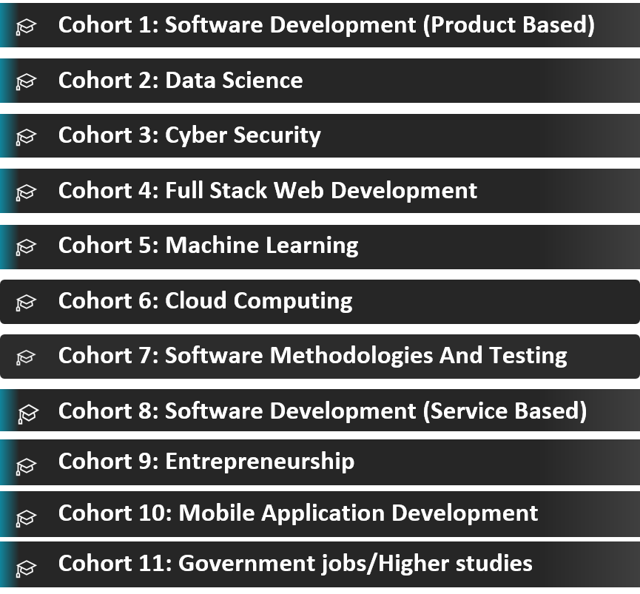
Outline Cohort’s:

Slide 10
Contents
Unit I
Computer Systems : Basic structure of computer and its working, Computer associated peripherals, Memories - RAM, ROM, Secondary storage devices, System Configuration – features and comparison (SSD vs hybrid, types of RAMs, Processors - cores/threads), BIOS Configuration, Compare and contrast PC connection interface (USB, SATA, HDMI, NFC, Bluetooth), RAID, GPU basics,
Synchronization across CPU and GPU.
Computer Languages : Machine language, Assembly language, High level language, Steps in development of a program, Compilation and Execution, Compiler, Interpreter, Assembler.
Unit II
Operating System : Operating Systems and its components, Windows Operating System Versions and features, Installation Process, Directory Hierarchy of Windows Operating System (Single level and multiple level), Bootloader.
Linux Operating System : Linux OS and its features, Distribution versions, installation process, Directory Hierarchy of Linux System (single level and multiple level)., Partitions: Understanding disk partitions and obtaining partition information using system tools, Comparison of windows and Linux OS, Virtual Machines.
www.lpu.in Lovely Professional University
10

Slide 11
Contents
Unit III
File system management : File system basics, Types of file systems ( FAT, GFT, HFS, NDFS, UDF, Extended file systems), Pipes and redirection, Searching the file system using find and grep with simple regular expressions, Basic process control using signals, Pausing and Resuming process from a Linux terminal, terminating a process, Adding/removing from search path using PATH variable.
Other Shell commands : ls, cat, man, cd, touch, cp, mv, rmdir, mkdir, rm, chmod, pwd, ps, kill, etc, Kernel and types of kernels.
Unit IV
Cohorts and Skill Sets : Introduction to Cohorts, Purpose of Cohorts, Companies, Skills required and skill sources for different Cohorts (Internal and External)
Types of Cohorts : Cloud Computing, Cyber Security, Data Science, Full Stack Development, Machine Learning, Software Methodologies and Testing, UI/UX, Metaverse and Internet of Things, Job Roles for Different Cohorts
www.lpu.in Lovely Professional University
11

Slide 12
Contents
Unit V
Pathways : Introduction to Pathways, Purpose of Pathways, Job Roles for Different Pathways, Types of Pathways: Product Based, Service Based, Government Jobs, Higher studies, Entrepreneurship MOOCs and Hackathons : Introduction to MOOCs and Hackathons, Types of MOOCs, Various MOOCs Platforms, Benefits of MOOCs, Globally Recognized Hackathons and Competitions, MAANG Companies.
UnitVI
Version Control : Overview of Git and GitHub, Install git and create a GitHub account, Create a local git repository, Add a new file to the repository, Creating a commit, Creation of a new Branch Profile Creation : Figma, GitHub, Stack overflow, HackerRank, HackerEarth, GeeksforGeeks.
www.lpu.in Lovely Professional University
12

Slide 13
Why Orientation to Computing?
As a computer science student in their beginner stage you need to know how the various things in computer work and how the computer is used in multiple instances.
You need to understand the brief descriptions of subjects that will be further explored in future subjects through your degree programme.
www.lpu.in Lovely Professional University
13

Slide 14
Evaluation Criteria
CA1: MCQ : will be objective-type containing 30 MCQ questions of 1 mark each, which includes analytical and logical scenario based questions.
CA2: Non-Technical Online Mooc course: Students will complete one non-technical mooc course(Minimum duration of 5 hr ) and submit the completion certificate.
CA3:Portfolio/CV creation: Students will prepare a CV and will create profiles and take insights of various platforms like Github, Stack overflow, Linked in, Hackerrank etc.
Rubrics to be followed-CV with one technical MooC course registration proof [10 marks]
GitHub with repositories and forks [10 marks]
Profile creation and activities by student on various technical platforms [10]
MTE: There will be no MTE applicable for this course.
ETE: ETE of this course involves MCQs based analytical, logical and scenario based questions. There will be 0.25% negative marking in MCQ.
www.lpu.in Lovely Professional University
14

Slide 15
Details of Course Enrichment Activities
As This course is a STAR Course. There will be certain activities that will be conducted throughout the course duration. The details of the activities are given below:
A. Role Play Activity: Each student will receive an assignment to investigate the operations of different functional components within a digital computer, such as SSD, USB, HDMI, NFC, Bluetooth, RAID, and GPU. After conducting their research, students will have the opportunity to share their findings with the class, with each presentation limited to a 3-minute timeframe.
B. Tool based execution of commands: Faculty will give demonstration of commands execution in ubuntu or other Linux platform/ PowerShell.
C. Live Demos: Utilizing web-based software like GitHub, live demonstrations will be conducted to offer insights into version control systems and their practical applications.
www.lpu.in Lovely Professional University
15

Slide 16
Details of Course Enrichment Activities
D. Techi-I- Follow: Each student will receive a designated company name and will be tasked with researching and analyzing the company's business processes. This includes gathering information about the necessary skills, as well as exploring details regarding salary packages and more.
Students will present his/her findings in a class within 3 minutes.
www.lpu.in Lovely Professional University
16

Slide 17
Any Questions???
www.lpu.in Lovely Professional University
17

